Slide 1
Lecture # 02
Prepared by: tahmina khan

Slide 2
Introduction to registers
In the CPU, registers are used to store information temporarily. That information could be one or two bytes of data. The registers of the 8086 fall into the six categories discussed in the table below:
Table 1: Registers of 8086 by category
Category | Bits | Register Names
General | 16 8 | AX, BX, CX, DX AH, AL, BH, BL, CH, CL, DH, DL
Pointer | 16 | SP (stack pointer), BP (base pointer)
Index | 16 | SI (source index), DI (destination index)
Segment | 16 | CS (code segment), DS (data segment), SS (stack segment), ES (extra segment)
Instruction | 16 | IP (instruction pointer)
Flag | 16 | FR (flag register)

Slide 3
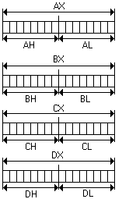
General Purpose Registers
The general purpose registers of the 8086 microprocessor can be accessed as either 16 bits or 8 bits as shown in figure.
The first letter of each general register indicates its use.
- AX is used for the accumulator.
- BX as a base addressing register.
- CX as a counter in loop operations.
- DX to point to data in I/O operations.
Figure 1: General Purpose Registers

Slide 4
Pointers Registers
The pointers will always store some address or memory location. In 8086 Microprocessor, they usually store the offset through which the actual address is calculated.
SP and BP may also be used as a general purpose register.
- SP (stack pointer) is used in the PUSH and POP instructions for operations on a LIFO (Last-In, First-Out) stack.
- BP (Base Pointer) is often used in addressing an array of data in the stack memory.

Slide 5
Segment Registers
A typical assembly language program consists of four segments:
- CS (code segment) contains the Assembly language instructions that perform the tasks that the program was designed to accomplish.
- DS (data segment) is used to store information (data) that needs to be processed by the instructions in the code segment.
- SS (stack segment) is used by the CPU to store information temporarily.
- ES (extra segment) used as an extra data segment. In many normal programs this segment is not used, its use is absolutely essential for string operations.

Slide 6
Index Registers
There are two types of index registers:
- SI (source Index) stores the offset address of the source.
- DI (destination index) stores the offset address of the destination.

Slide 7
Instruction Pointer
It Points to the location of next instruction to be executed in current code segment.
It can be modified with CALL & JUMP instructions.
16-bits (IP) in real mode and 32-bits in protected mode.

Slide 8
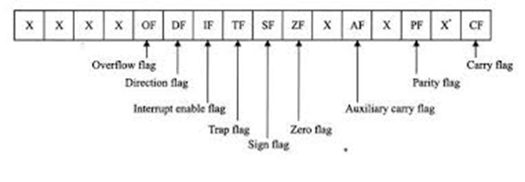
Flag Register
It is a 16 bits register sometimes referred to as the status register.
It is a 16 bits wide register, but only some of the bits are used.
Six of the flags are called conditional flags, indicate some condition that resulted after an instruction was executed. CF, PF, AF, ZF, SF and OF are conditional flags.
Three of the flags are called control flags, they are used to control the operation of instructions before they are executed. DF, IF and TF are control flags.
Seven of the flags are undefined or reserved by Intel.
Figure 2: Flag Register

Slide 9
Conditional Flags
CF (carry flag) - set to 1 when the result of an addition has a carry out of the most significant byte. Other instructions can also affect C (e.g. subtraction)
PF (parity flag) - set to 1 if the low order byte of the result contains an even number of ones; otherwise it is set to zero.
AF (auxiliary carry flag) - set to one if there is a carry out of bit 3 during an addition or a borrow by bit 3 during subtraction.
ZF (zero flag) - set to 1 if the result is zero; Z is otherwise zero.
SF (sign flag) - equal to the most significant bit of the result (i.e. set to 1 if the result is negative)
OF (overflow flag) - set if a result is out of range (e.g. when adding two positive numbers and the result appears negative)

Slide 10
Control Flags
DF (direction flag) - in certain string manipulation instructions, D determines whether the string is processed from the lowest address (D=0) or the highest address (D=1).
IF (interrupt flag) - determines whether a maskable interrupt is recognized by the microprocessor. If IF=1, a maskable interrupt is possible, otherwise the interrupt is ignored.
TF (trap flag) - if T=1, a trap (e.g. for single stepping through a program) is executed after every instruction.

Slide 11
Flags Example
Example: Show how the flag register is affected by the addition of 38H and 2FH.
Solution:
38 0011 1000
2F 0010 1111
67 0110 0111
CF = 0 since there is no carry beyond D7
AF = 1 since there is a carry from D3 to D4
PF = 0 since there is an odd number of 1s in the result
ZF = 0 since the result is not zero
SF = 0 since D7 of the result is zero

Slide 12
Practice Questions
Example: Show how the flag register is affected by the addition of 9CH and 64H.
Example: Show how the flag register is affected by the addition of 34F5H and 95EBH.
Example: Show how the flag register is affected by the addition of AAAAH and 5556H.
Example: Show how the flag register is affected by the addition of 94C2H and 323EH.

Slide 13
Introduction to Program segments
A segment is an area of memory that includes upto 64K bytes and begins on an address divisible by 16.
8085 could address 64Kbytes 16 address lines
In the 8085, 64 K is for code, data, and stack
In the 8086/88, 64 K is assigned to each category
Code segment
Data segment
Stack Segment
Extra Segment

Slide 14
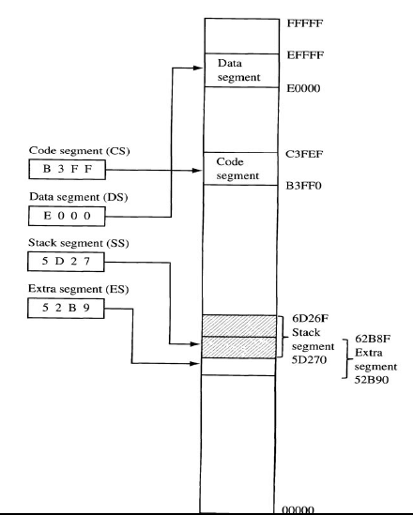
Segment Registers Example

Slide 15
Physical & logical address
In Intel literature concerning the 8086, there are three types of addresses mentioned frequently: the physical address, the offset address and the logical address.
The physical address is the 20-bit address that is actually put on the address pins of the 8086 microprocessor and decoded by the memory interfacing circuit.
The offset address is a location within a 64K bytes segment range.
The logical address consists of a segment value and an offset address.

Slide 16
Physical & Logical Address Example
Example: If CS = 2500H and IP = 95F3H, show (a) the logical address, and (b) the offset address. Calculate (c) the physical address, (d) the lower range of CS and (e) the upper range of CS.
Solution:
Logical address = CS : IP = 2500 : 95F3
Offset address = IP = 95F3
Physical address = (CSx10H)+IP = 2E5F3
Lower range = 25000 + 0000 = 25000
Upper range = 25000 + FFFF = 34FFF

Slide 17
Practice Questions
Example: If CS = 24F6H and IP = 634AH, show (a) the logical address, and (b) the offset address. Calculate (c) the physical address, (d) the lower range of CS and (e) the upper range of CS.
Example: If DS = 5000H and IP = 1950H, show (a) the logical address, and (b) the offset address. Calculate (c) the physical address.
Example: If DS = 7FA2H and the offset is 438EH, show (a) the logical address. Calculate (b) the physical address, (c) the lower range of DS and (d) the upper range of DS.
Example: Assume that the DS register is 578C. To access a given byte of data at physical memory location 67F66, does the data segment cover the range where the data resides? If not, what changes need to be made?
Example: If SS = 3500H and SP = FFFEH, show (a) the logical address, and (b) the offset address. Calculate (c) the physical address, (d) the lower range of stack and (e) the upper range of stack.

Slide 18
stack
The stack is a section of read/write memory (RAM) used by the CPU to store information temporarily.
If the stack is a section of RAM, there must be registers inside the CPU to point to it.
The two main registers used to access the stack are SS (stack segment) register and the SP (stack pointer) register.
These registers must be loaded before any instructions accessing the stack are used.
The storing of a CPU register in the stack is called a ‘push’, and loading the contents of the stack into the CPU register is called a ‘pop’.

